Slide 1

Mental Health Matters
NAVIGATING YOUR WELLNESS JOURNEY
STARS @SLU- JUNE 5TH, 2026
Knieba Jones-Johnson, LMFT
Director - SLU University Counseling Center

Slide 2

Common Myths
01
Adolescents don’t have mental health issues
02
Mental health challenges are a sign of weakness/being crazy
03
Mental health problems develop because one isn’t trying hard enough
04
Practicing self-care can resolve all mental health issues
05
One should only seek help if things are severe
06
Going to therapy solves all mental health issues

Slide 3

Current Trends
20%
40%
20%
+55%
20%
Adolescents reported symptoms of anxiety in the past two weeks
High school students who reported persistent feelings of sadness or hopelessness in the past year
High school students who reported seriously considering attempting suicide in the past year
Of U.S. adolescents reported discussing their mental and emotional health with a health care professional
Adolescents who reported receiving mental health therapy

Slide 4
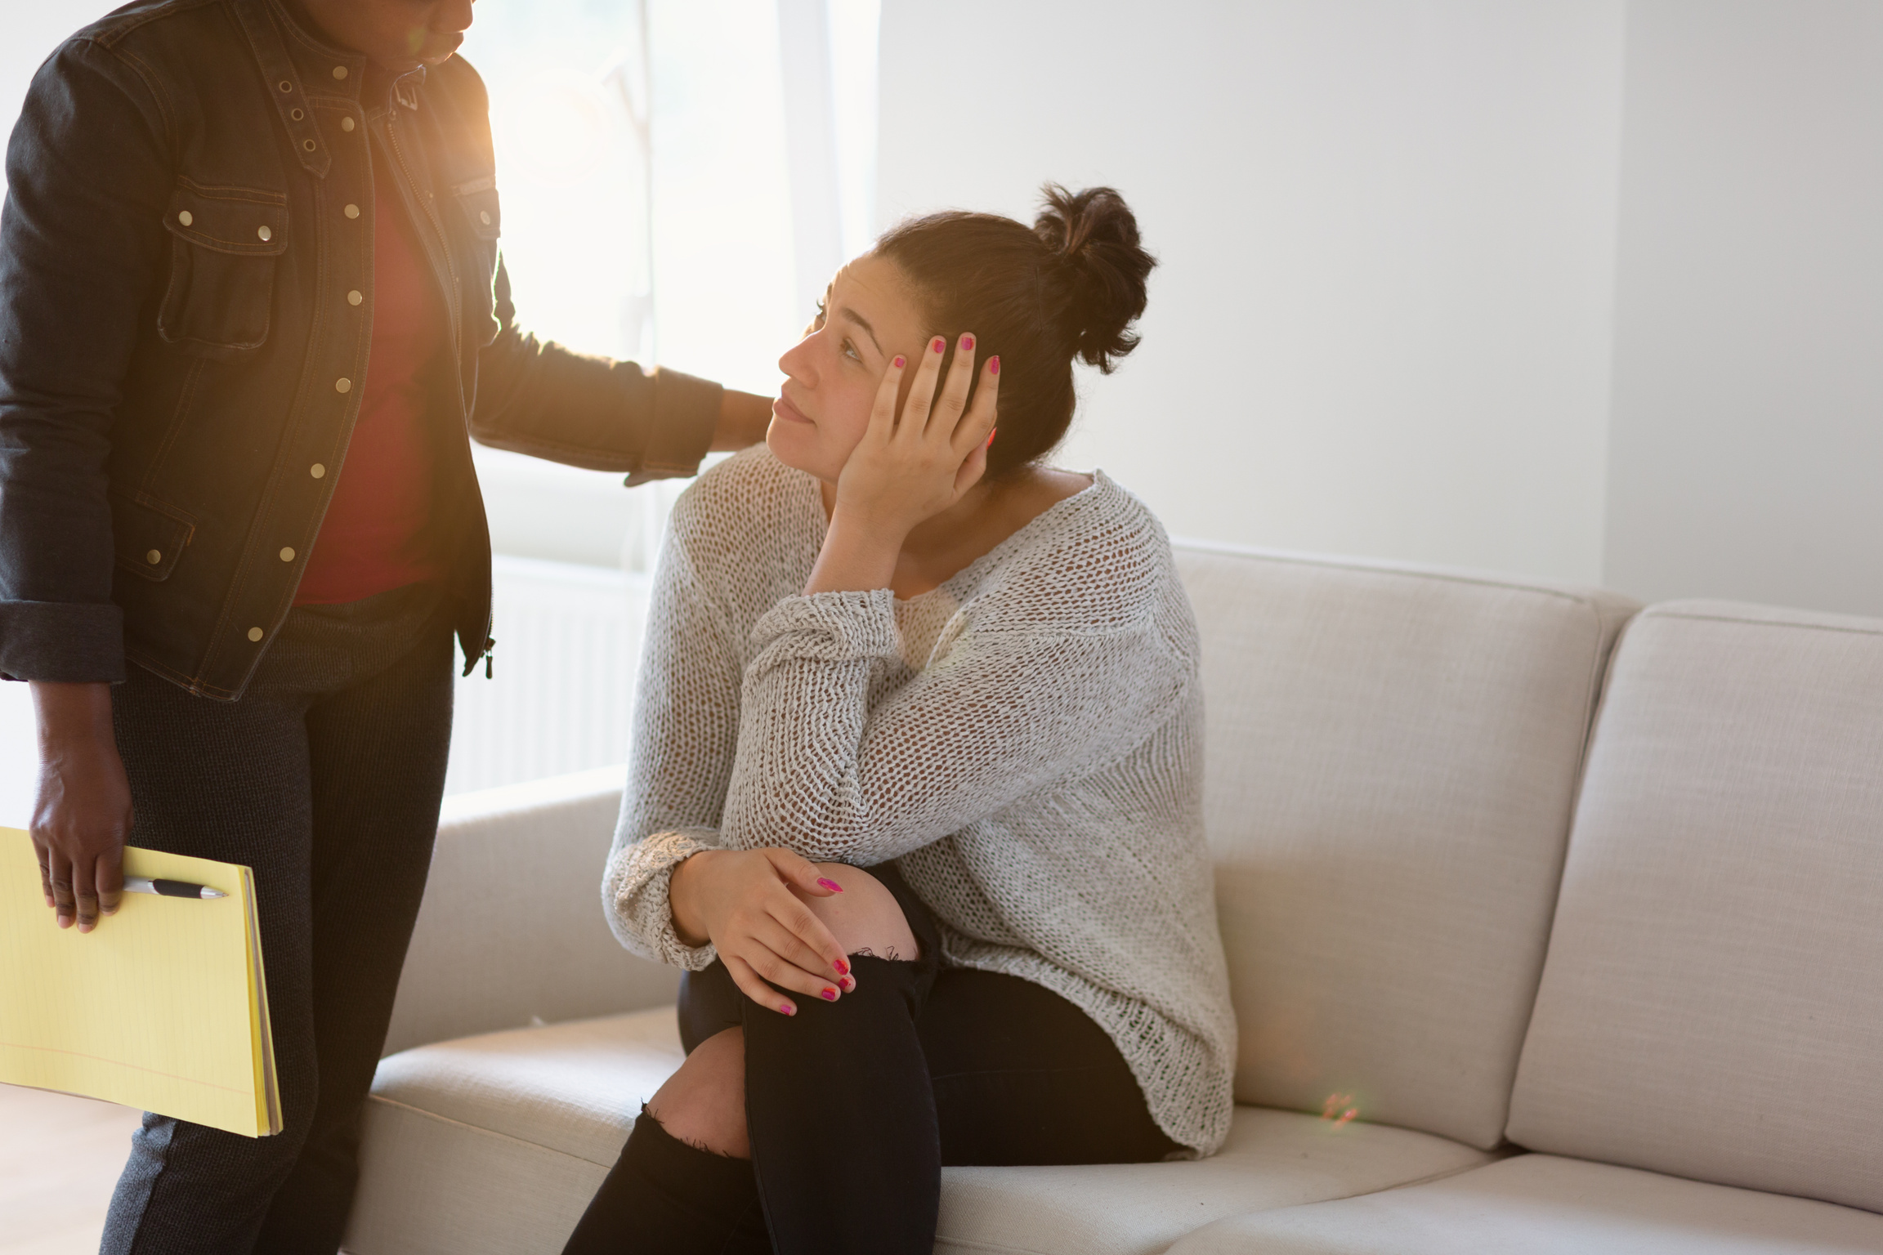

Current Trends
Center for Collegiate Mental Health, Annual Report (2025)
Anxiety continues to be the most common presenting concern, with 64.9% of clients experiencing anxiety as assessed by clinicians. Relationship problem (specific) continued to show an upward trend as a top concern since 2020, while Trauma remained largely unchanged after reaching its highest level in 2022–2023.
History of counseling continued to be the mental health history item with the largest 12-year increase: over 64% of students entered services with prior counseling
In 2024–2025, the prevalence rates for histories of non-suicidal self-injury (29.2%) and suicide attempt(s) (11.3%) reached their highest levels since this data has been collected.

Slide 5
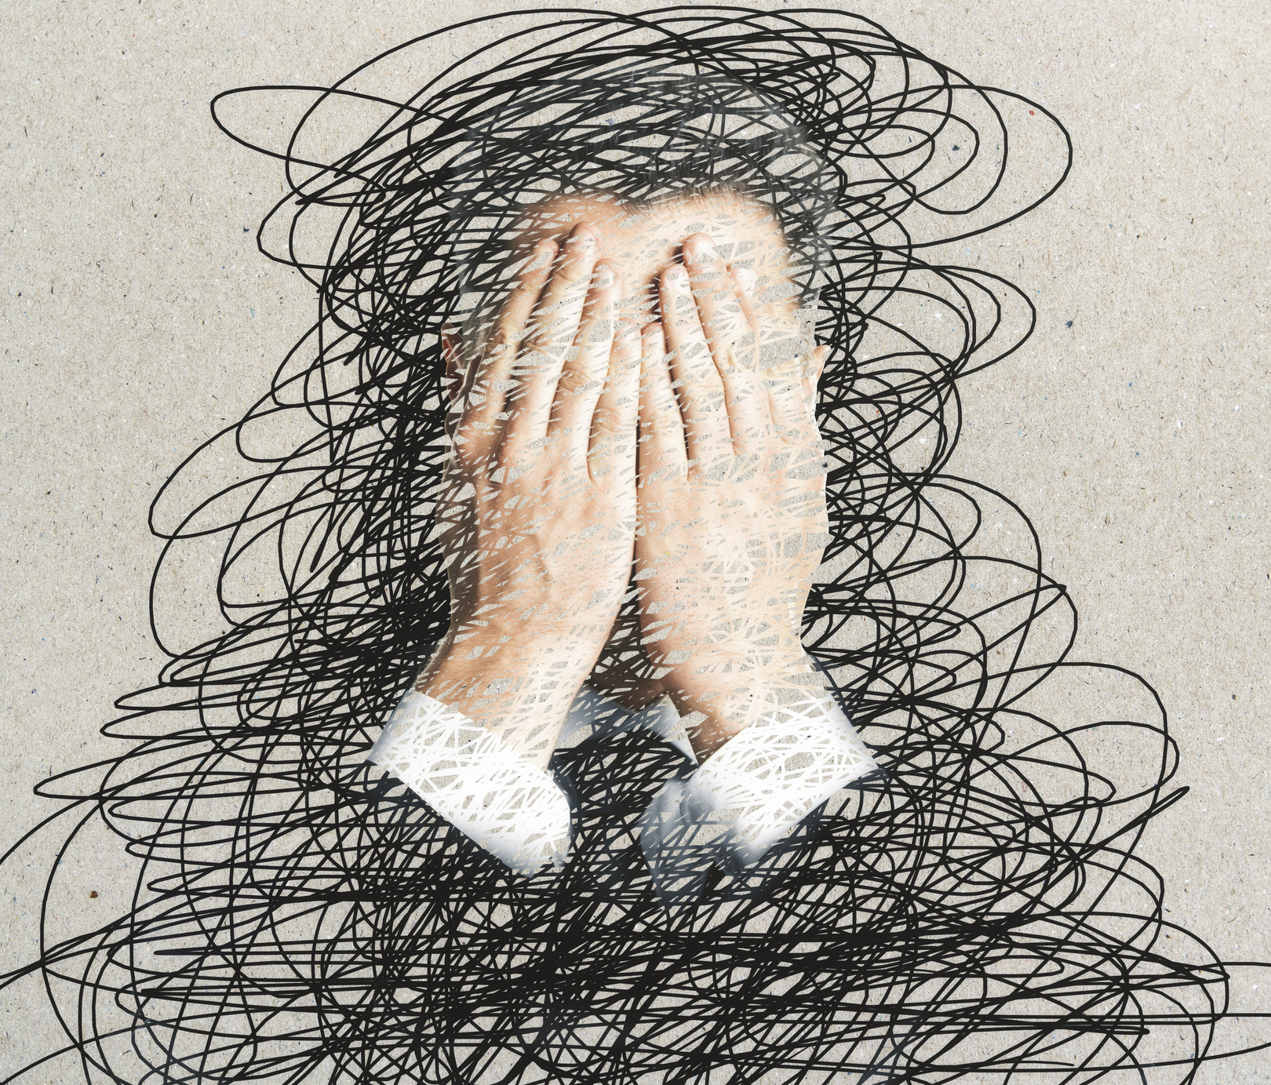
Factors and Influences
01
Grind Culture
02
Political and Cultural Divisiveness
03
Global Pandemic
04
Perceived Connectivity of Technology
05
Proliferation of Social Media
06
Growing Inequities

Slide 6


Common Signs of Mental Health Challenges
Inconsistent attendance and/or performance
Trouble communicating/expressing feelings
Changes in hygiene/appearance/sleep/eating habits
Mood lability/dysregulation
Erratic and/or unpredictable behavior

Slide 7
Tearfulness/exhibiting clear distress
Common Signs of Mental Health Challenges
Extreme nervousness/excessive worry
Agitation/aggression/threats of violence
Disconnection from reality/hallucinations/delusions
Suicidal ideation/statements

Slide 8

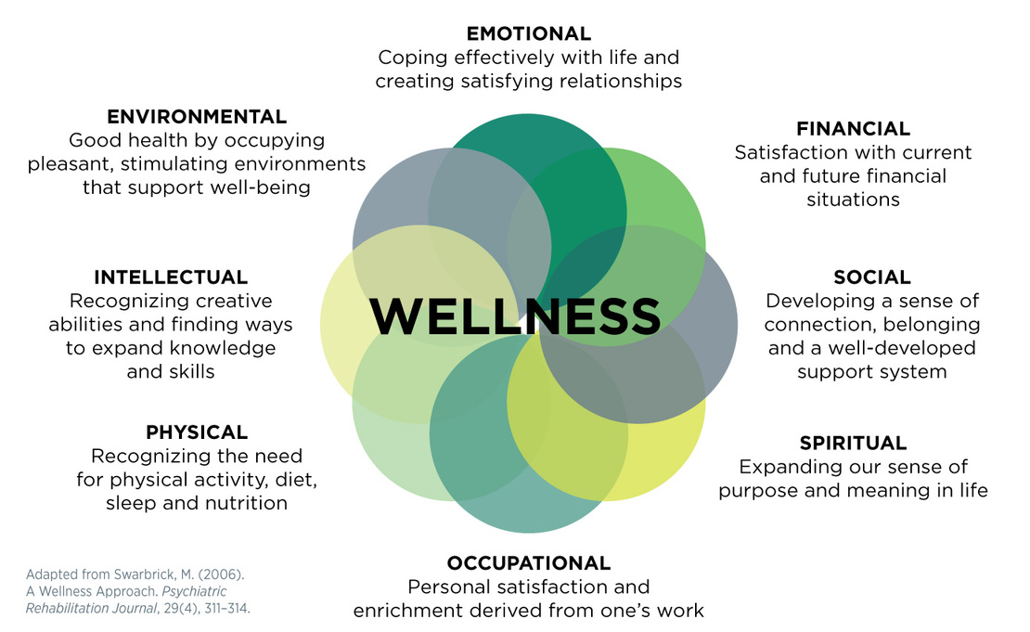
DIMENSIONS
OF
WELLNESS

Slide 9

Community Care
"People committing to leveraging their privilege to be there for one another in various ways" - Nikita Valerio

Slide 10
Wellness Tips
Doing The Minimum
M.E.D.S. Rx
Create the Day
Habit Joining
Identify Your Sanctuary

Slide 11
Wellness Tips
Brain Dump
Sensory Break/Sensory Stimulation
Support Roster
S.L.O.W. Down (Stop, Look, Observe, Wait)
Move

Slide 12


College Wellness Tips
Familiarize yourself with resources
Create a daily wellness routine
Join organizations
Strive for alignment
Visit the counseling center
Create community
Connect with nature
Volunteer
Meet regularly with professors and advisors
Build in rest
Excellence over perfectionism

Slide 13

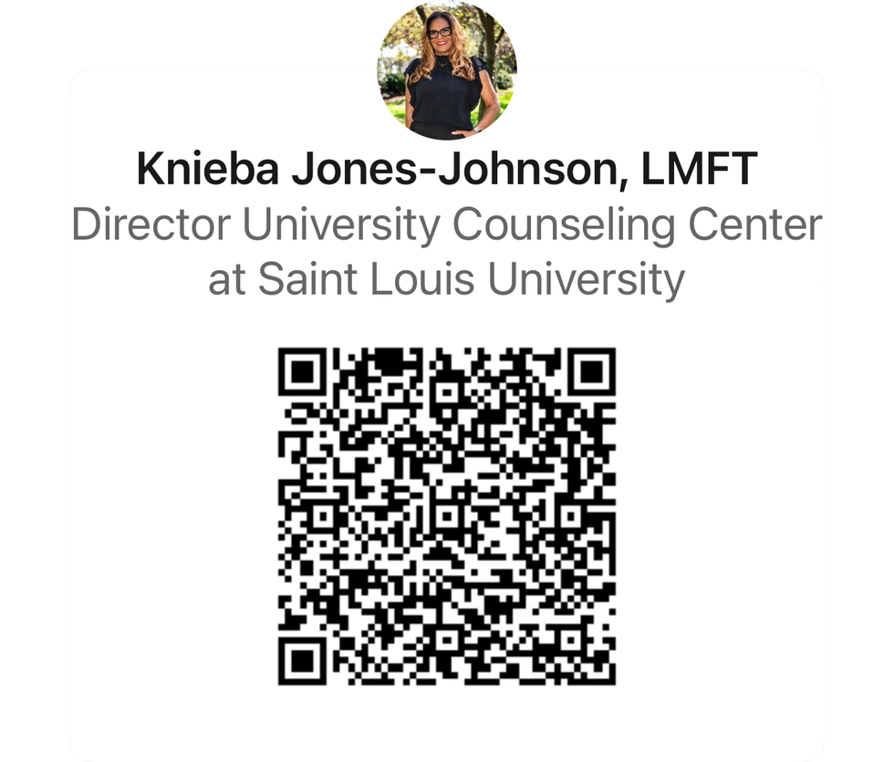
STAY CONNECTED

